Slide 1


Animal and Plant Health Inspection Service Plant Protection and Quarantine
Erin Otto
Lacey Act Program
May 2024
Erin.M.Otto@usda.gov

Slide 2
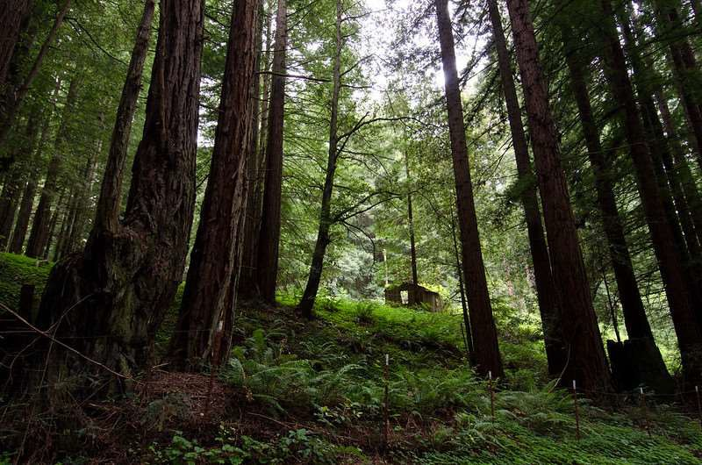
Objectives
Lacey Act Overview
Program Status
What’s Next?

Slide 3
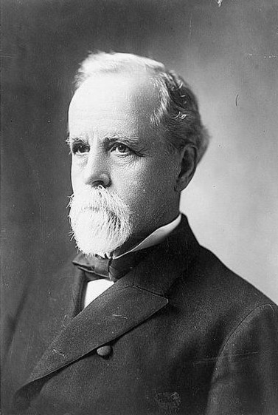


Interstate shipment of unlawfully killed game
The Lacey Act of 1900
Hunting to supply commercial markets
John Fletcher Lacey

Slide 4

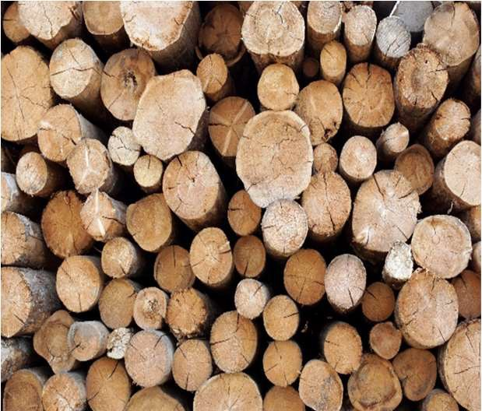
Lacey Act 2008 Amendments
Covers more plants and plant products, including wood products
Imposes legal requirements
Requires an import declaration

Slide 5

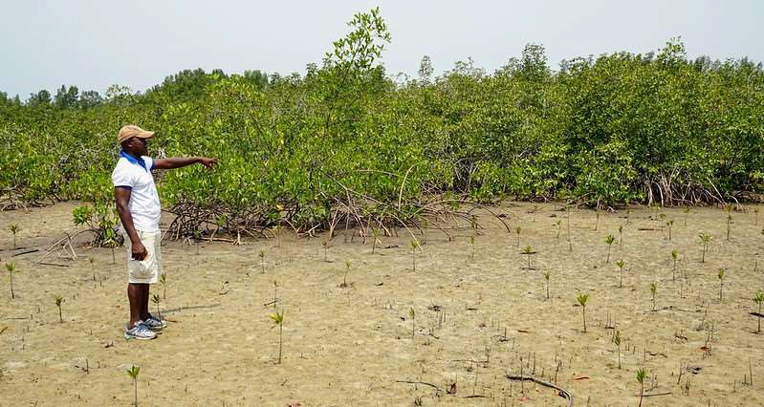
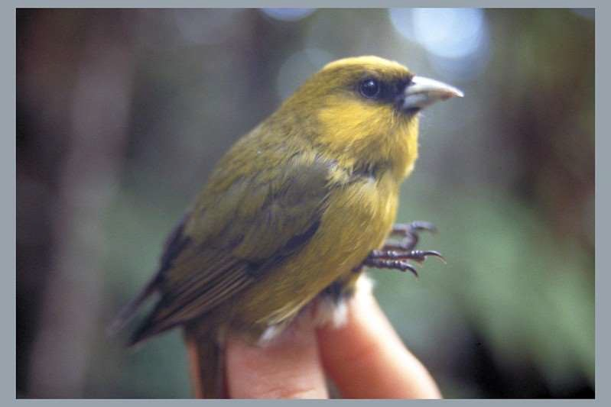
Combatting Illegal Trade
Illegal logging leads to:
  Increased Greenhouse Emissions
  Loss of Biodiversity
  Deforestation
  Corruption and Violence
  Revenue losses for U.S. businesses

Slide 6


What are the Requirements?
All imported plants and plant products must have been legally harvested, possessed, sold or transported.
Articles imported under the act require a declaration stating:
Value and quantity
Country plant was taken
Scientific name of each plant in product (Genus and species)

Slide 7













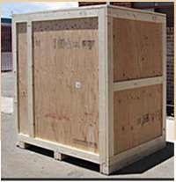
Does not require a declaration?
Exemptions
Wood products used as packaging material
Products that meet the de minimis
criteria
Common Food Crops
Common Cultivars (except trees)
Scientific Specimens
Plants for planting
This Photo by Unknown Author is licensed under CC BY

Slide 8




Exclusions do not apply to Protected Plants!

Slide 9

Lacey Program Status
Phases I-VI implemented
Phase VII – slated for 2024 implementation
Phase VIII – composites

Slide 10
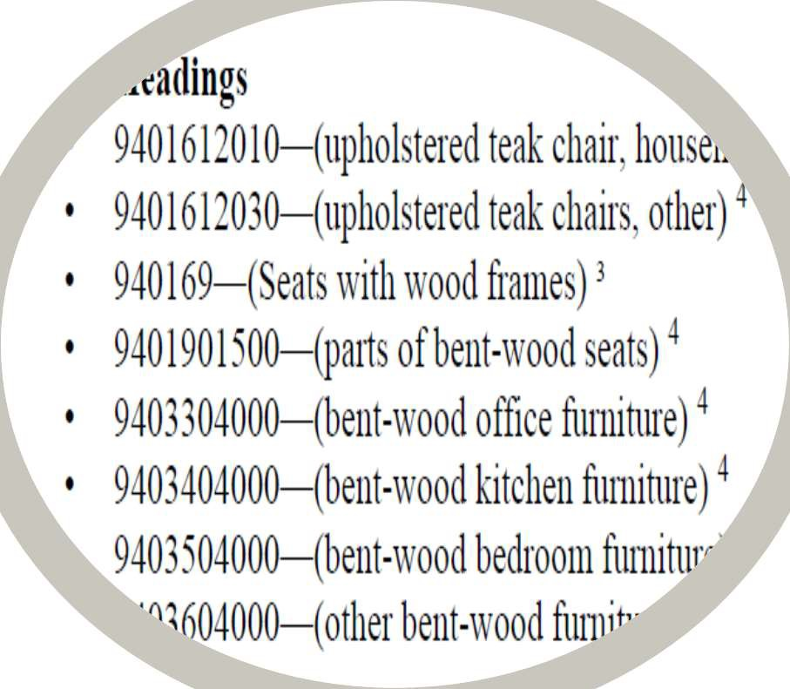

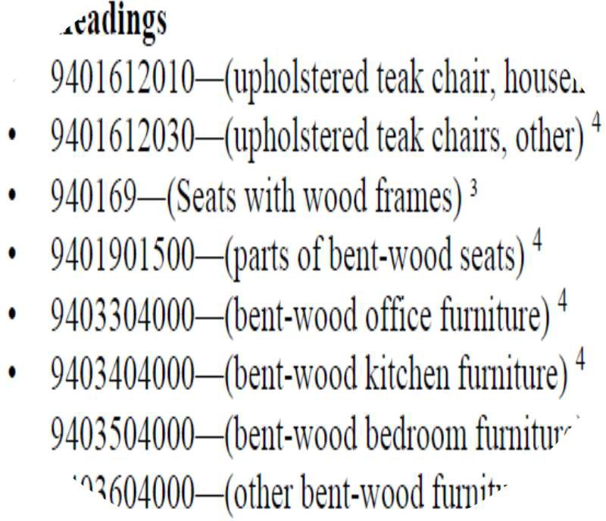




Schedule of Enforcement
Chapter 93
See tariff codes in each chapter

Slide 11

Lacey Act Program – What’s Next?
Phase 7 - all remaining non- composite plant products, such as wooden furniture
Federal Register Notice of HTS codes with full implementation 2024

Slide 12
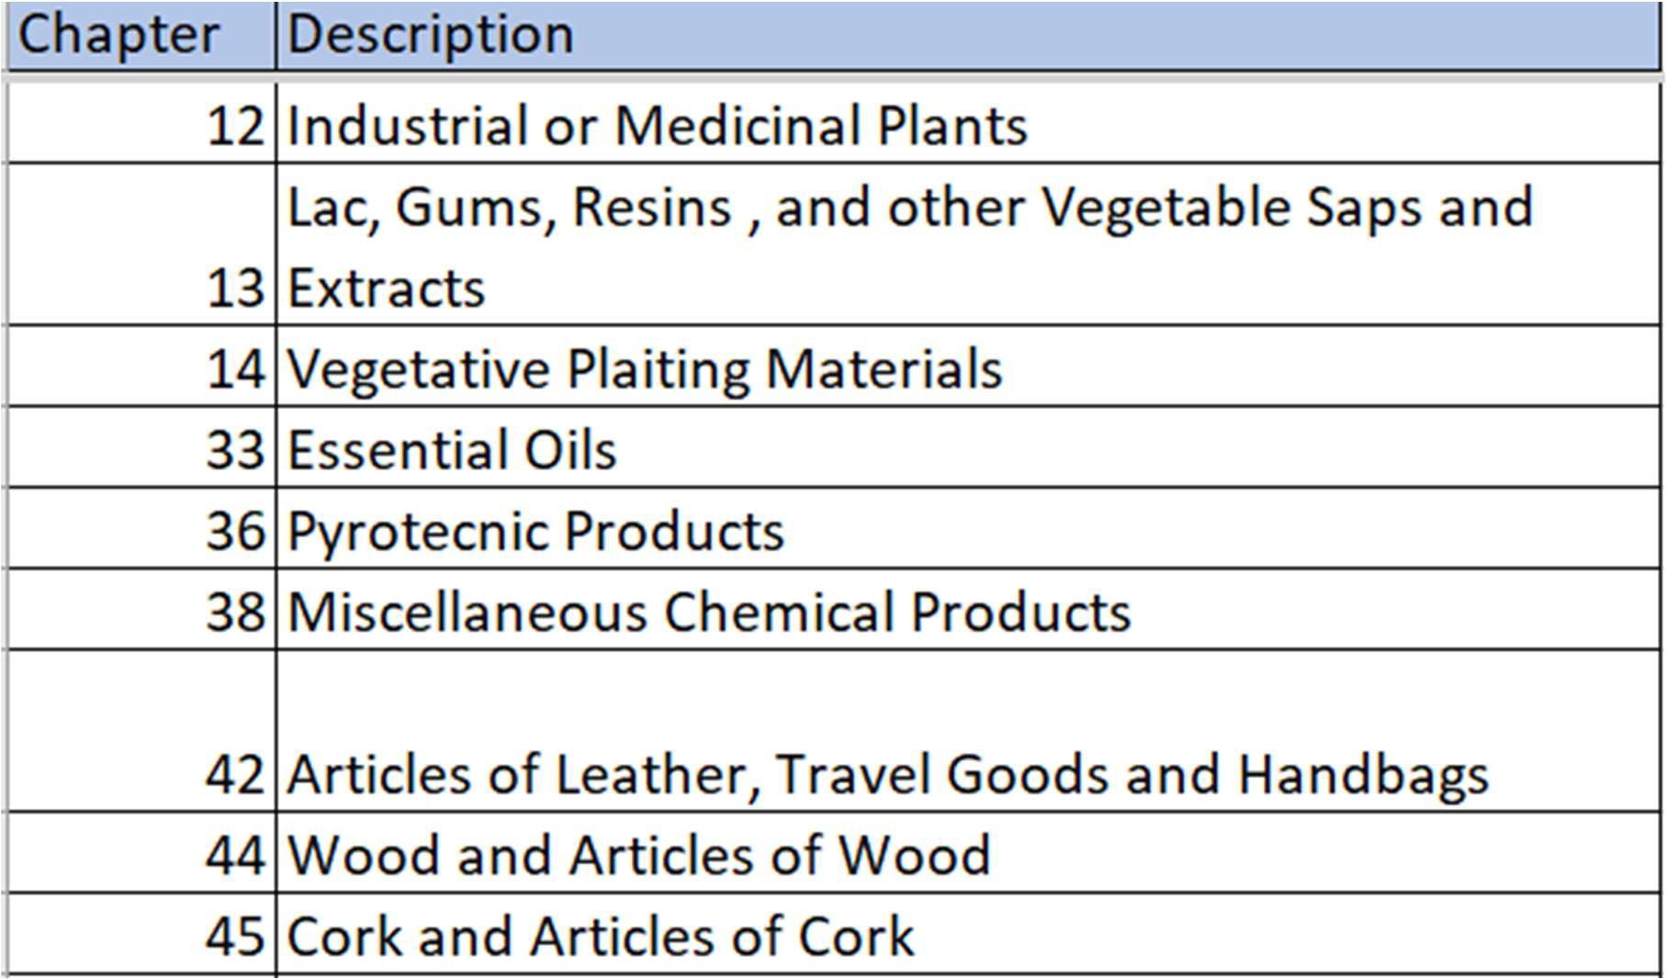
Draft
Phase VII - Harmonized Tariff Schedule (HTS) Code Chapters

Slide 13
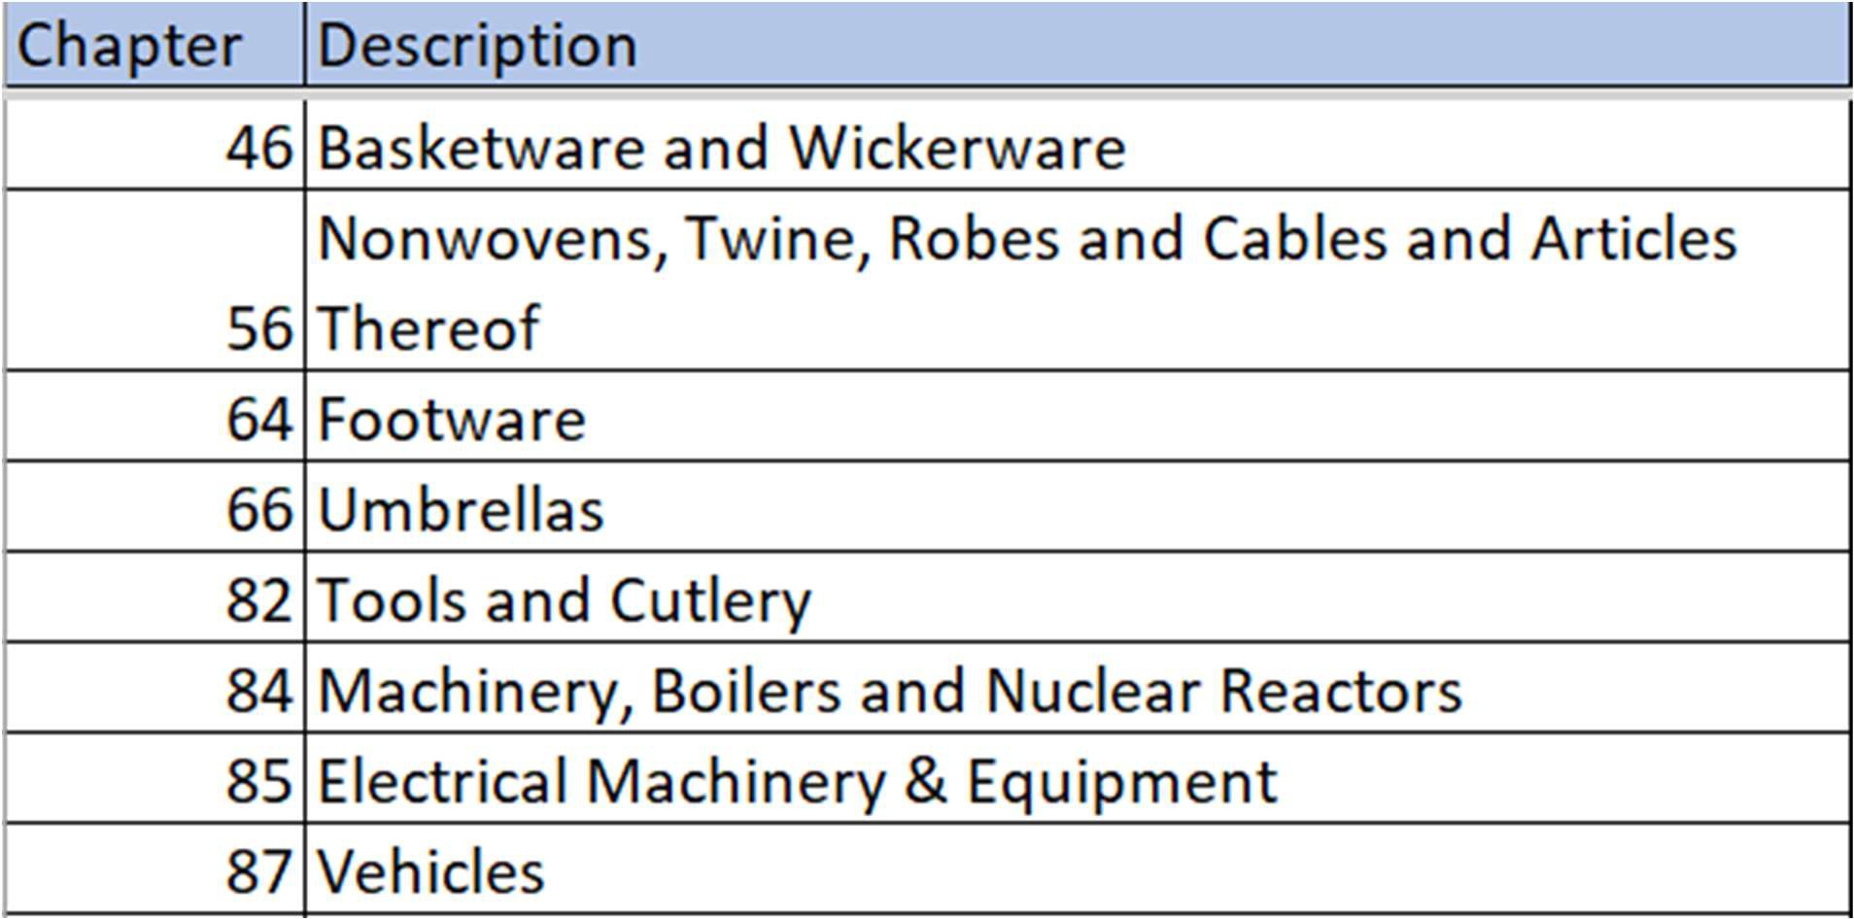
Draft
Phase VII - Harmonized Tariff Schedule (HTS) Code Chapters

Slide 14
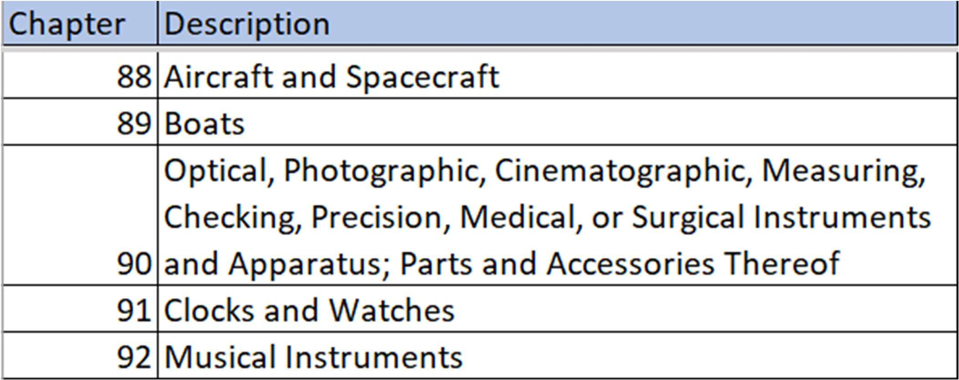
Draft
Phase VII - Harmonized Tariff Schedule (HTS) Code Chapters

Slide 15
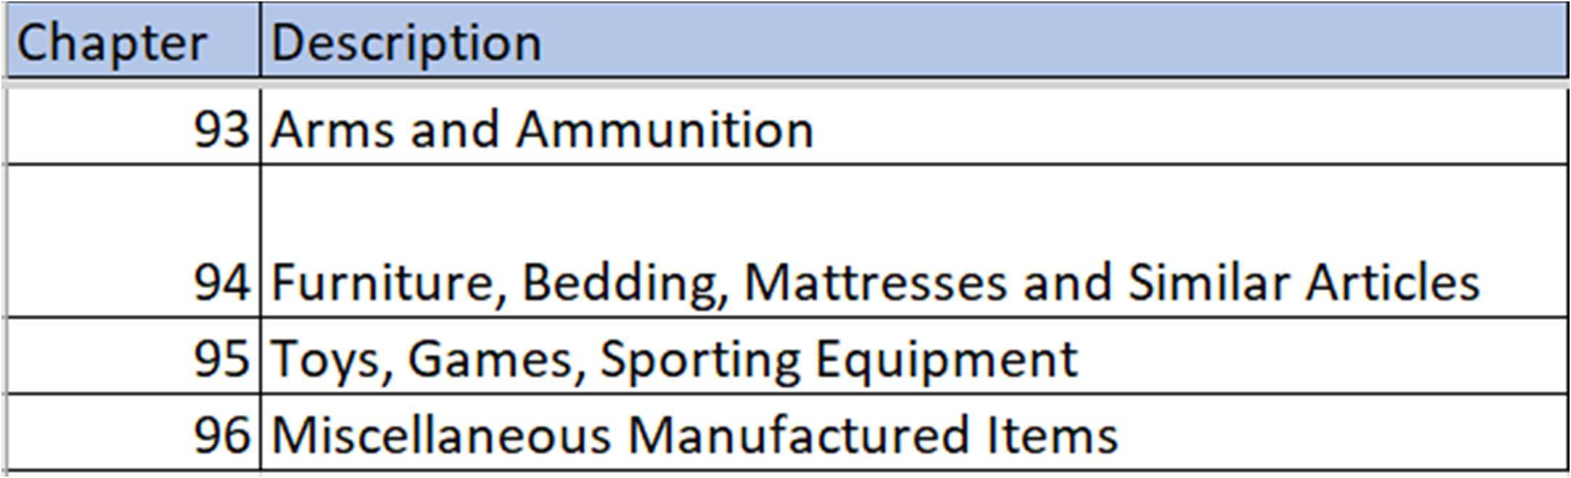
Draft
Phase VII - Harmonized Tariff Schedule (HTS) Code Chapters
A full list of HTS codes will be published as a notice in the Federal Register and declarations will be required 6 months after publication date.

Slide 16


Slide 17


Slide 18

Bottom line:
If the HTS code is flagged for Lacey, you will need species and country of harvest information for:
Articles containing wood or plant products
Plant products not 100% composite material that are not otherwise exempted

Slide 19




Lacey Act Program – Additional Projects

Slide 20
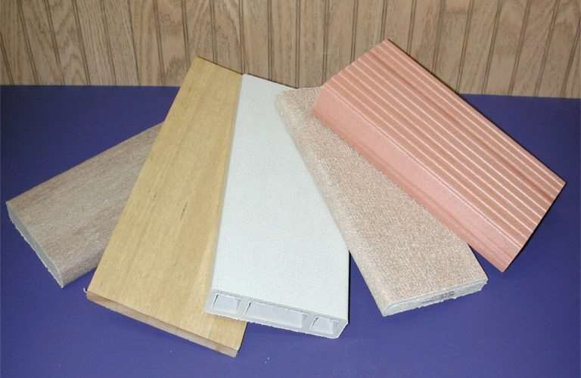


Lacey Act Program – What’s Next?
Phase VIII
– All remaining composite materials

Slide 21


APHIS Lacey Act Website
https://www.aphis.usda.gov/plant- imports/lacey-act

Slide 22

Contact Us
USDA, APHIS
Lacey.Act.Declaration@usda.gov
Promoting responsible harvest to save the world’s forests

